Slide 1
Compsys 302 Python project
Login Server Based Social Media Network
Adil Bhayani

Slide 2

Project Requirements
Allows a user to log onto the system
The system should be able to automatically find other users that are on the same network
The system allows users to create and maintain their profiles for others to be able to view them
Messaging and file sharing with other users including support for all file types
Allows users to see other users that are online

Slide 3
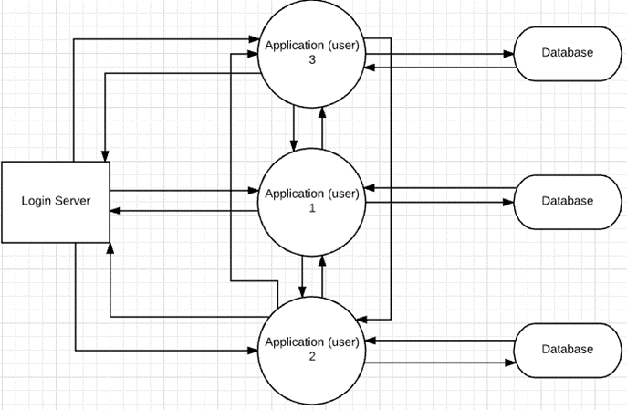
System top level diagram
3 Main components:
Login Server
Individual Applications
Individual Databases

Slide 4
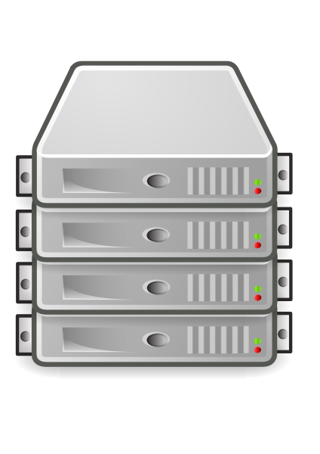
Login server
Maintains a list of all users
Allows nodes to report to it (log in)
Keeps track of online users
Returns list of online users and their public keys

Slide 5

Individual applications
Connect with one another after obtaining IP and port from Login server
Send messages, files, status and profiles to one another
Display data received from other applications on their own User Interface
Interact with their respective databases to store received and sent data

Slide 6

Individual databases
Sqlite3 databases
Stores data from the application nodes in different tables
Return the values requested by the application nodes

Slide 7
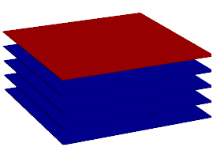
Tools used (Technology stack)
Python: Interpreted programming language used to run CherryPy (v 2.7)
CherryPy: A minimalist python web framework as the webserver
Sqlite3: SQL database engine for maintaining database
HTML, CSS, JavaScript: User side User Interface and interaction
Visual studio code: Python IDE

Slide 8
Special Features
Support for offline messaging and file sending
Beautiful, intuitive and user friendly UI
2 Factor Authentication, with randomly generated secret key saved on application on a per user basis
Search for a users profile and then message
Supports hashing standards 1-4 and encryption 1-3

Slide 9
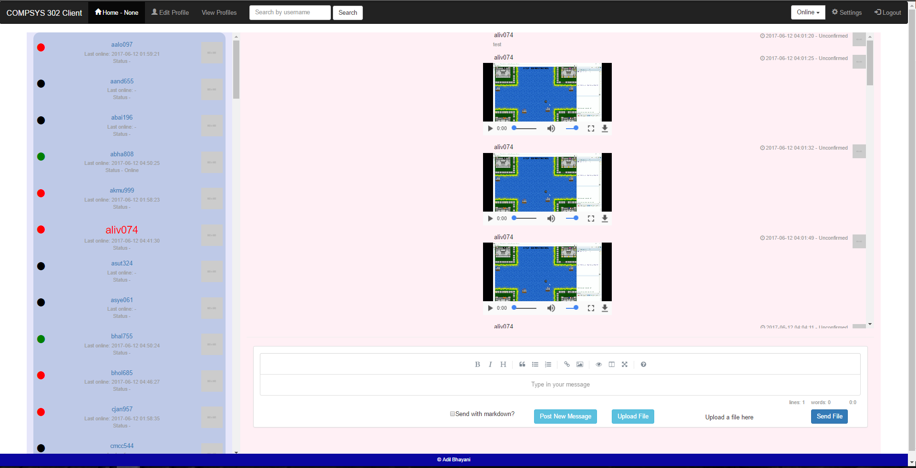
Home page

Slide 10

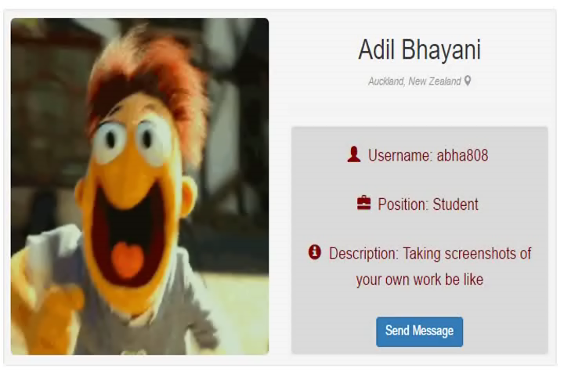
Profile Page
Displays users details in pleasant to view manner
Allows user to search for another user and direct message

Slide 11

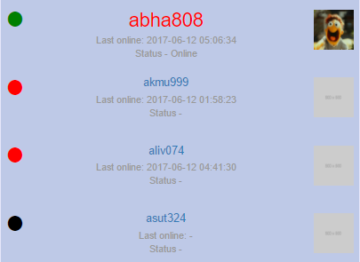
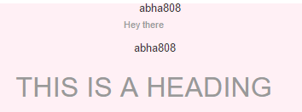

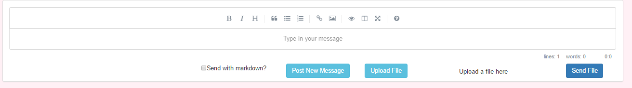
Users side panel
Markdown and message confirmation
Displays selected user as highlighted red
Shows user status
Displays profile pictures once retrieved
User status can be set from navbar
Markdown option and dedicated markdown editor
Message status for messages

Slide 12
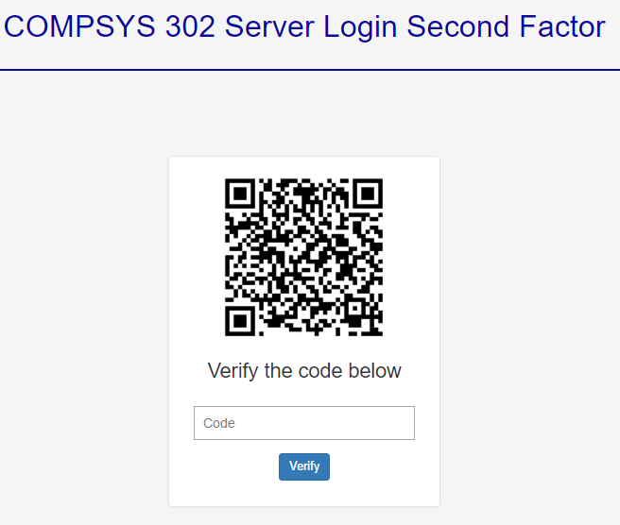
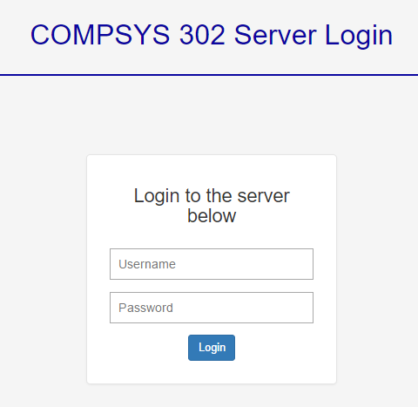
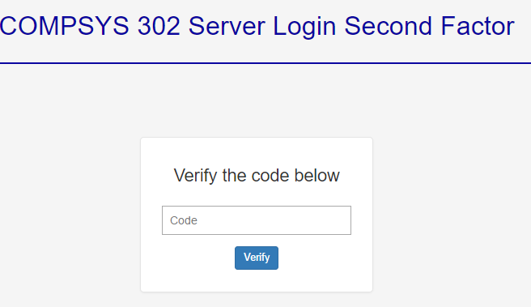
2 Factor Authentication
First login generates secret code
QR code not displayed after first login

Slide 13

Project requirements met?
Basic requirements met
Inter-app security
Pleasing UI
Markdown support
Two Factor Authentication

